Slide 1
Digital Portfolio
STUDENT NAME: Aravind.K
REGISTER NO AND NMID: 222402586/C81C76E22191E5A8F1C43FC7C5A99CAD
DEPARTMENT: Computer Science With Data Science
COLLEGE: Prince Shri Venkateshwara Arts and Science collage / Madras UNIVERSITY

Slide 2
PROJECT TITLE
Digital journey

Slide 3


AGENDA
Problem Statement
Project Overview
End Users
Tools and Technologies
Portfolio design and Layout
Features and Functionality
Results and Screenshots
Conclusion
Github Link
3/21/2024 Annual Review

Slide 4

PROBLEM STATEMENT
Recruiters have limited time to review applications.Lengthy resumes may cause important skills to be missed.They prefer quick insights into strengths and achievements.A digital portfolio gives them a clear, interactive overview.

Slide 5

PROJECT OVERVIEW
Interactive Skills PortfolioThe project focuses on showcasing my technical and analytical skills in Data Science. My skills are displayed with progress bars or charts, along with About Me, Education, Hobbies, and Contact sections supported by my profile image.

Slide 6

WHO ARE THE END USERS?
The portfolio is designed for potential employers and industry professionals, allowing them to quickly understand my strengths, education, and technical skills.

Slide 7

TOOLS AND TECHNIQUES
HTML → For writing the content such as About Me, Education, Skills, and Hobbies.
CSS → For formatting text, setting background colors, and styling images.
Web Browser → To test and view the portfolio while developing.
GitHub → To upload and make the portfolio publicly available.

Slide 8
POTFOLIO DESIGN AND LAYOUT
Home → A welcome message with my name and profile image.
About Me → A short paragraph about myself.
Skills → A simple bullet or numbered list of my skills.
Education → Details in table format or plain text (School, College, Year).
Hobbies → A simple list of hobbies.
Contact → My phone number, email, and address in plain text.
Responsive → On mobile, everything stacks in a single column.
8

Slide 9
FEATURES AND FUNCTIONALITY
Navigation menu – quick access to all pages.About Me section – short introduction about myself.Skills highlight – shows my technical strengths.Hobbies section – shares my personal interests.Contact details – easy way to reach me.

Slide 10
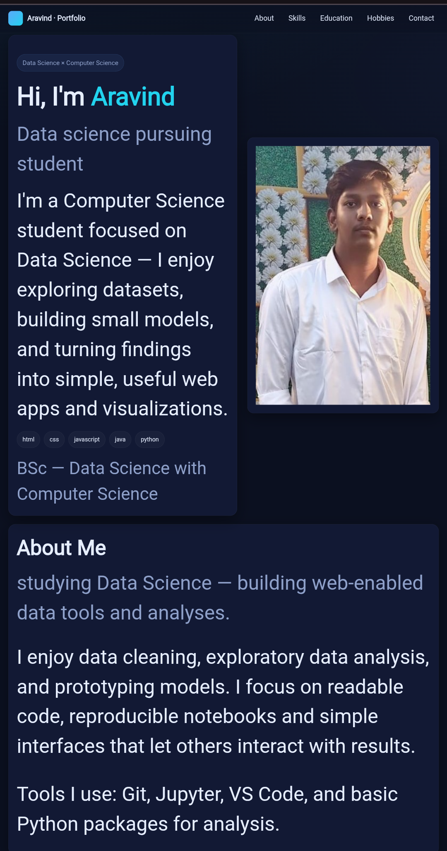
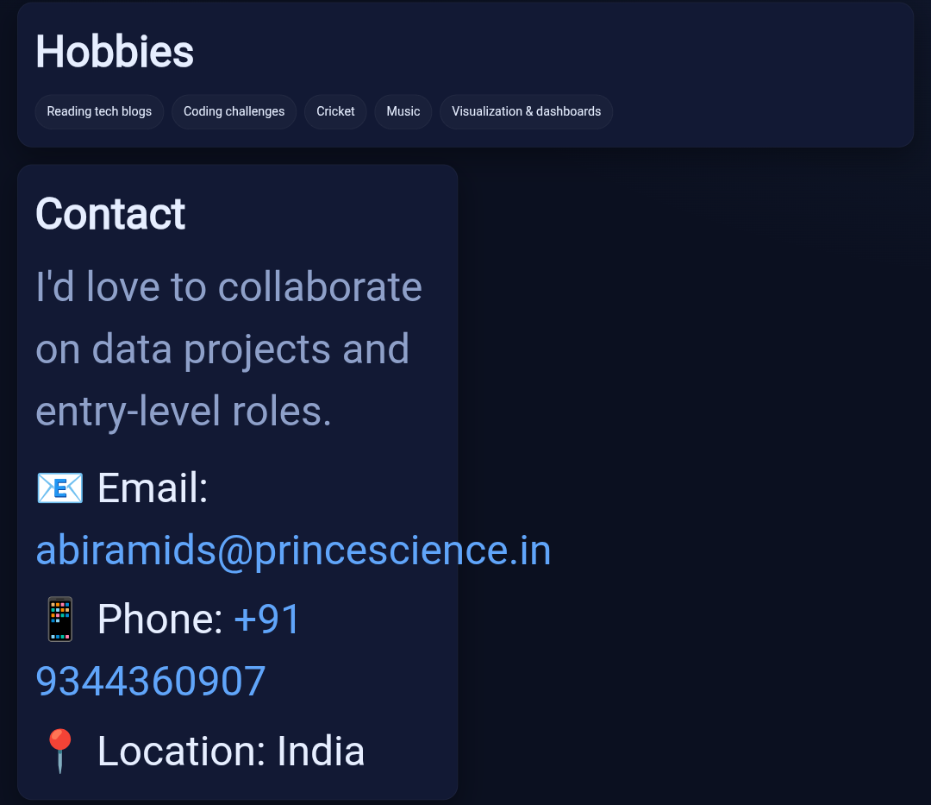

RESULTS AND SCREENSHOTS
3/21/2024 Annual Review
10

Slide 11
CONCLUSION
This portfolio gives a clear idea about me.It has sections like About Me, Skills, and Education.The layout is simple and well organized.Anyone can view it easily on mobile or desktop.It is a basic start for my professional journey.
11

